Slide 1
Introduction to Computer Organisation and Architecture
Lecture 7
Peripheral Devices

Slide 2
Contents
Magnetic Disk
RAID
Optical Disk
CRT
LCD

Slide 3
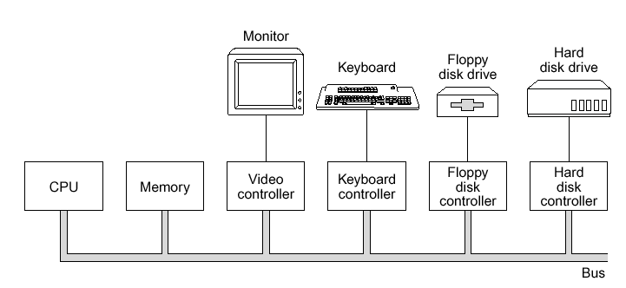
Peripheral Devices
Peripherals: devices that are separate from the basic computer (Not the CPU, memory, power supply)
Classified into input, output and storage
Output peripherals - Video Display, Printers
Input peripherals - Keyboard, Mouse, Joystick, Scanners
Storage Peripherals – hard disk
Connected through:
Ports (parallel, USB, serial)
Interface to system bus (SCSI, IDE, PCMCIA)

Slide 4
Storage Devices
Storage devices also known as mass media or auxiliary storage, refers to the various media on which a computer system can store data.
There are two type of storage:
Primary memory
Volatile
Temporary
Secondary storage
Non volatile
Permanent
No matter how big the main memory is, it is always too small.

Slide 5
Magnetic Disk
A disk drive often has several disks stacked vertically.
Each disk surface requires at least one radially movable head to read or write information from the disk
A disk is a circular platter (3- to 12-cm diameter) constructed of non-magnetic material, called the substrate (aluminum or aluminum alloy, or recently glass), coated with a magnetizable material (iron oxide…rust).
The assembly is placed in a drive that causes it to rotate at a constant speed.

Slide 6
Magnetic Disk
Traditionally, the substrate can be made from aluminium or aluminium alloy.
Recently, glass subtrates have been introduced because of the following reasons:
Improvement in surface uniformity of the magnetic film surface → higher reliability
Reduction in surface defects → Reduced read/write errors
Better stiffness → to reduce disc dynamics
Better shock and damage resistance

Slide 7
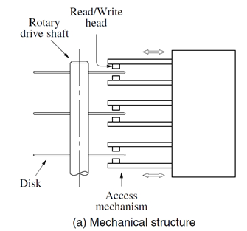
Read and Write Mechanism
Data access is performed mechanically: The disk is spinned on the spindle or rotary drive shaft.
Data are recorded on and later retrieve from the disk via a conducting coil named the head.
The read/write head moves to the correct position by extending/contracting the access arm.
A head performs either a read or write operation, the head is stationary while platter rotates beneath it at an uniform speed.
In most modern hard disk, the thin magnetic film is deposited on both sides. The same head (read/write head) is also typically used to perform both read and write.

Slide 8
Read and Write Mechanism
The write mechanism exploits the fact that electricity flowing through a coil produces a magnetic field. Electrical pulses of suitable polarity are sent to the write head. The magnetization of the film in the area immediately below the head will switch to a direction parallel to the applied field.
Traditional read head :
During read, the coil serves as a sense coil. Changes in the magnetic field in the vicinity of the head caused by the movement of the film relative to the yoke induce a voltage in the coil. The polarity of the voltage detected by the coil is used to determine the binary state.
Uses the same coil for both read and write.
Slow due to mechanical constraint (bigger size of the read/write head)

Slide 9
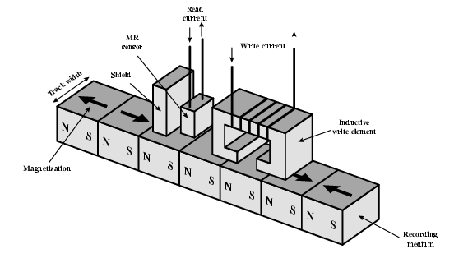
Read and Write Mechanism
Contemporary read head:
Separate read head, close to write head
Partially shielded magneto resistive (MR) sensor.
Electrical resistance will change depending on the direction of the magnetic field.
By passing current to the MR sensor, resistance changes will be detected as voltage signals (V = IR)
Able to perform at higher frequency and density

Slide 10
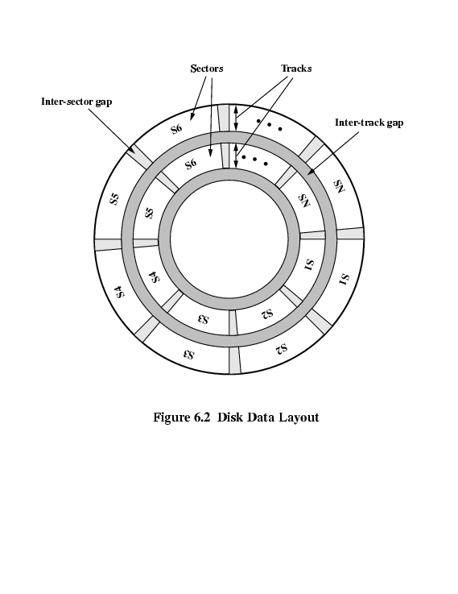
Data Organization and Formating
Before any data can be read/written into disk, it must be formatted.
Formatting is the process of dividing the disk into track and sector.
Tracks
Track is the organization of data on the platter in concentric set of rings.
Adjacent tracks are separated by gaps to prevent or minimize errors due to misalignment of the head or interference of magnetic fields
A typical disk may contain >100 to several thousand tracks.

Slide 11
Data Organization and Formating
Sector
Tracks are divided into sectors, normally between 64 and 128 sectors per track
Each sector typically contains one block of data 512 bytes (4096 bits).
To avoid unreasonable precision requirement adjacent sectors are separated by inter-sector gaps.
Cluster
A group of segments belonging to the same track
Cylinder
The set of tracks at a given radial position (distance from spindle) # cylinders in the disk = #tracks in a single platter

Slide 12
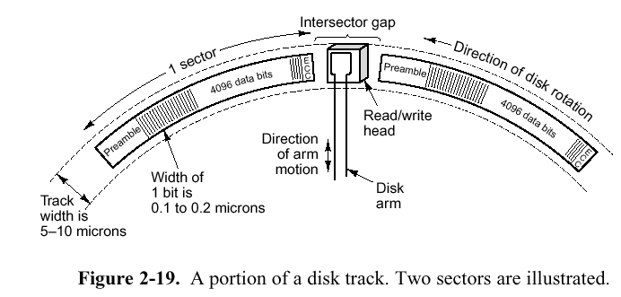
Data Organization and Formating
Each sector contains 512 bytes.
The data is preceded by a header which contains the ID of the sector. The data is followed by the error-correcting code (ECC) to detect and correct errors that may have occurred in writing or reading the data bytes.
for synchronization
error correcting code
sector header for addressing

Slide 13
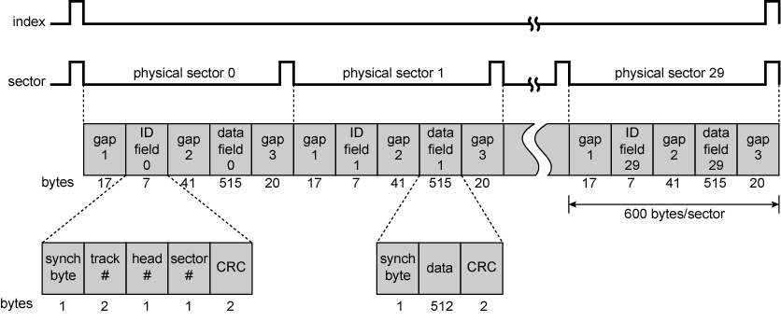
Winchester Disk Format (Seagate ST506)
Example of disk formatting:
30 fixed-length sectors of 600 bytes each
12 bytes of data + control information
ID is the unique identifier (address) to a particular sector
SYNC delimits the beginning of the field

Slide 14
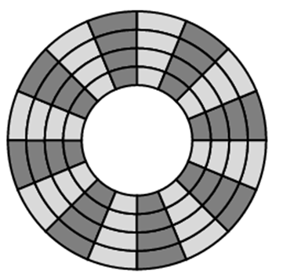
Disk Velocity
Bit near centre of rotating disk passes fixed point slower than bit on outside of disk (the same amount of time is used to cover a longer distance in the outer tracks) → inconsistency in speed.
How to handle speed inconsistency?
Constant Angular Velocity (CAV)
Multiple Zoned Recording (MZR)
Constant Angular Velocity (CAV)
Rotate disk at constant angular velocity (CAV) Increase spacing between bits in different tracks
Gives pie shaped sectors and concentric tracks
Individual tracks and sectors addressable
Move head to given track and wait for given sector
Waste of space on outer tracks
Lower data density

Slide 15
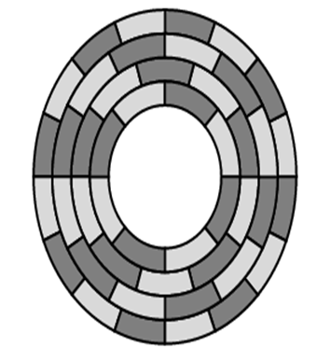
Multiple Zoned Recording
Track are groups into concentric zones based on their distance to the spindle. Within each zone, the number of bits per track is constant. Zones farther from the center contain more bits than zones closer to the center.
Designed to support high density secondary storage
Same number of bits per sector but different number of sectors per track (Fewer sector in the inner tracks).
Transfer rate will become inconstant for different sectors (need different speed for the read head, since rotation speed is constant).
Data on the outer most zone will have the highest data transfer rate. This is typically where the OS is stored.

Slide 16
Physical Characteristics of Disk Systems
Fixed (rare) or movable head
Fixed: one read write head per track. Arm is rigid
Movable: one read write head per side. Arm is movable
Removable or fixed
Removable: can be removed from drive. Smaller capacity
Fixed: permanently mounted such as HDD
Single or double (usually) sided

Slide 17
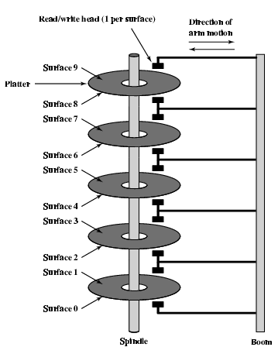
Physical Characteristics of Disk Systems
Single or multiple platter
For multiple patters, all the heads are mechanically fixed so that all are at the same distance from the centre of the disk → moves at the same time.
Example of a multiple Platter Disk

Slide 18
Physical Characteristics of Disk Systems
Head Mechanism
Contact (floppy)
Fixed gap between the head and the tracks
Aerodynamic Gap (Winchester).
The head must be sufficiently near to the surface to generate (sense) sufficiently strong electromagnetic field to write/read properly.
The narrower the head → the narrower the track → the denser the disk (desirable)
The narrower the head, the closer the head needs to be to the disk.
Winchestor head is an aerodynamic foil that rests lightly on the surface when motionless. It fly on boundary layer of air as disk spins → very small head to disk gap.

Slide 19
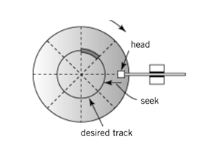
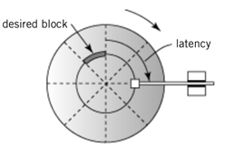
Magnetic Disk
Average Seek time
Average time to move the head from one track to the destination track
Average seek time for magnetic disk ranges from 5 to 8ms
Average Latency time
Average time to rotate to the beginning of the sector.
On average, this is half a rotation of a disk
Rotation_speed is specified in terms #rotations/min or #rotations/sec
1/rotation_speed is the time needed to complete reading 1 track
Avg. Latency time = 0.5 * (1/rotation_speed)

Slide 20
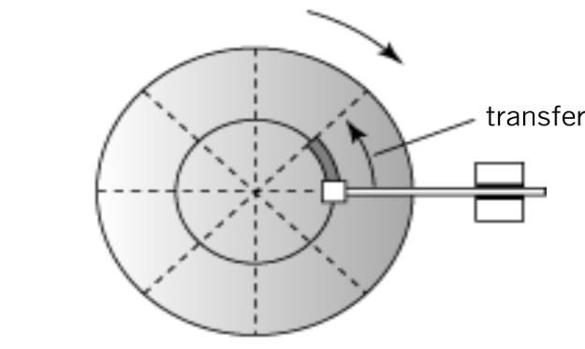
Disk Access Time
Average block transfer time
(1/rotation_speed) / #sectors_in_one_track
The time required to transfer a block of data (one segment) to the disk controller buffer
Equivalent to the time to perform one rotation divided by the #sectors in one track
Average time to access a disk block
average seek time + average latency time + average block transfer time
Data Transfer Rate
# bytes in a track * rotation_speed
The rate of data movement between the disk and the computer

Slide 21
Disk Access Time
Example 1:
Suppose a disk system has the following properties
20 data-recording surfaces
15,000 cylinders (= #tracks per surface)
An average of 400 sectors per track
Each sector contains 512 bytes of data
Average seek time = 6ms
Average latency = 3ms
Rotation = 10K rotations per minute
What is the total capacity of the disk?
20 × 15,000 × 400 × 512 ≈ 60 gigabytes
What is the transfer rate (for each surface) in bytes/sec?
10K rotations/minute = 10K/60 = 1666.67 rotations/sec
Transfer rate = #bytes_per_track x rotations_per_sec
= 400 x 512 x 1666.67 = 341334016 bytes/second
= 341.334016 x 10⁶ bytes/sec ~ 341MB/sec

Slide 22
Disk Access Time
Example 2:
Consider a disk unit with 24 recording surfaces, 14K cylinders and average 400 sectors per track. Each block contains 512 bytes of data. The rotation speed is 7200 rotations per minute (rpm).
What is the capacity of the disk?
Capacity = #surfaces x #tracks x #sectors_per_track x #bytes_per_block
= 24 x 14000 x 300 x 512 = 68,812,800,000 = 68.8 x10⁹ bytes ~ 69 GB.
What is the data transfer rate ?
7200 rotations per minute → 7200/60 = 120 rotations per second.
Size of one track = #sectors x # bytes_per _block = 400 x 512 = 204,800 byte
Number of bytes per second = size of one track x #rotations per second
= 204,800 x 120 = 24576000 ~ 25MB/sec
What is the maximum and minimum latency time for this disk?
Minimum latency time = 0 s (when the head is parked at the desired sector)
Maximum latency time ~ Time for 1 rotation = 60/7200 seconds
= 0.0083125 seconds

Slide 23
RAID
Speed improvement for storage devices cannot keep up with the speed improvement of processor and even semiconductor memory.
Reliability improvement to recover data when any hard disk crashes.
Solution: use multiple magnetic disk drives operating in parallel to provide a high-performance and high-reliability storage unit
RAID: Redundant Array of Inexpensive Disk.
Set of several physical disks but viewed as a single logical drive by the OS
Data is distributed across physical drives while redundant capacity can be used to store parity information

Slide 24
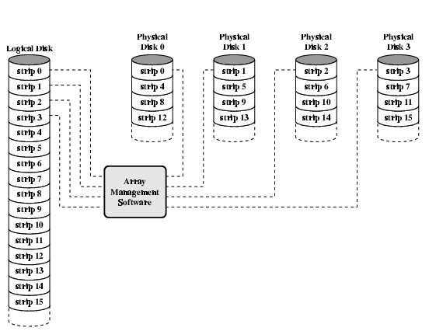
RAID 0 – Stripped Array
Data Stripping: A single large file is stored in several separate disk units by breaking the file into a number of blocks, which are then written simultaneously to different disks (round robin stripping)

Slide 25
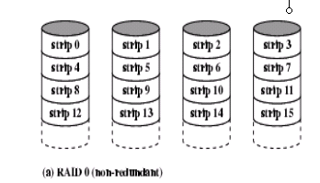
RAID 0 – Stripped Array
Array management software (can execute as part of the disk subsystem or host computer) maps the logical to the physical disk space.
When read, all disk are accessed in parallel.
Individual pieces of the data are buffered, and the complete file are reassembled and transferred to the memory as a single entity.
In a transaction-oriented environment (many I/O requests by one/different applications), load balancing is required.
Advantage:
High transfer rate if the size of data to be transferred is much larger than the strip size
Disadvantage:
Cannot recover data if any disk is corrupted.

Slide 26
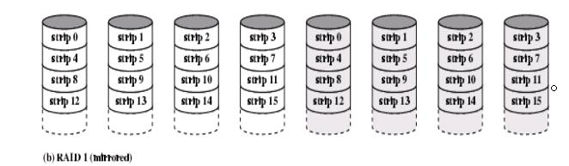
RAID 1 – Mirror Array
Primary Set
Mirror Set
Provides better reliability by storing identical copy (mirror) of the data in another disk set rather than just one.
For write operations, write to both disks – performance is governed by the slowest disk. No write penalty.
For read operations, read request is serviced by the disk with the minimum seek time plus the rotational latency.
If a read failure occurs in one of the drives, the data are read from another drive and the bad block marked to prevent future use of block, increasing system reliability.
Very costly way to improve reliability (identical copies of data)
In a transaction environment, good for read, no advantage for write.

Slide 27
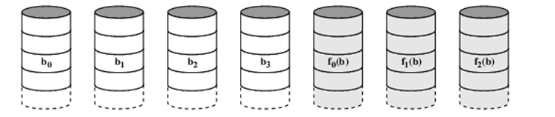
RAID 2
Make use of parallel access technique
Very small stripes
Often single byte/word
Disks are synchronized – Disk heads are in the same position on each disk at any given time.
Error correction calculated across corresponding bits on disks
Multiple parity disks store Hamming code error correction in corresponding positions
Requires fewer disk than RAID1 but still lots of redundancy
Expensive
Not used

Slide 28
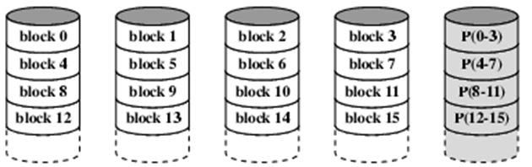
RAID 3
Similar to RAID 2 (parallel access technique)
Only one redundant disk, no matter how large the array
Simple parity bit for each set of corresponding bits
X4(i) = X3(i) ⊕ X2(i) ⊕ X1(i) ⊕ X0(i)
Data on failed drive can be reconstructed from surviving data and parity info. Assuming X1 has been corrupted, X1 can be recovered using the following operation:
X1(i) = X4(i) ⊕ X3(i) ⊕ X2(i) ⊕ X1(i)
Strength: Very high transfer rates because data is stripped in very small strips
Weakness: Only one I/O request can be executed at a time → Not good for transaction-oriented environment (many I/O requests at a time)

Slide 29
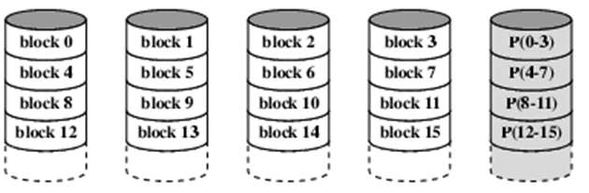
RAID 4
Different from RAID 2 and RAID 3, each disk operates independently (no synchronization of disk heads)
Good for transaction-oriented environment (high I/O request rate)
Large stripes.
Bit by bit parity calculated across stripes on each disk.
Weakness: Slow write operation. When X1 changes to X1_new, to avoid reading from all user strips (4 reads + 1 write), we can compute the new parity bit X4_new using only X4, X1 and X1_new (involves two read and two write):
X4_new(i) = X3 ⊕ X2 ⊕ X1_new ⊕ X0
= X3 ⊕ X2 ⊕ X1_new ⊕ X0 ⊕ 0
= X3 ⊕ X2 ⊕ X1_new ⊕ X0 ⊕ X1 ⊕ X1
= X3 ⊕ X2 ⊕ X1 ⊕ X0 ⊕ X1_new ⊕ X1
= X4 ⊕ X1_new ⊕ X1

Slide 30
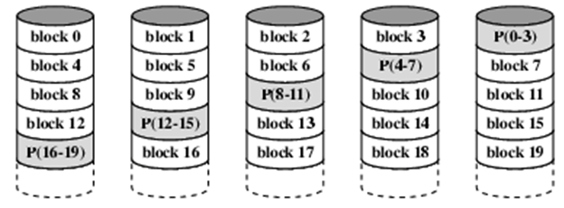
RAID 5
Like RAID 4
Parity striped across all disks
Round robin allocation for parity stripe
Avoids RAID 4 bottleneck at parity disk
Commonly used in network servers

Slide 31
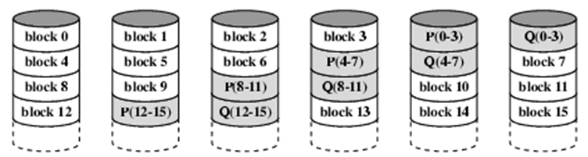
RAID 6
High data availability
Three disks need to fail for data loss
Significant write penalty
Uses two parity bits so that it is possible to
Stored in separate blocks on different disks
User requirement of N disks needs N+2

Slide 32
Optical Memory (CD-ROM)
Compact Disk Read Only Memory (CD-ROM)
Technology used for audio CD and computer CD-ROM are similar.
Data is stored on an optical medium (reflective materials) and read using a laser light source
Non-erasable read-only memory for storing computer data.
Typical capacity for a 12-cm disk is more than 650Mbytes (70 minutes of audio)

Slide 33
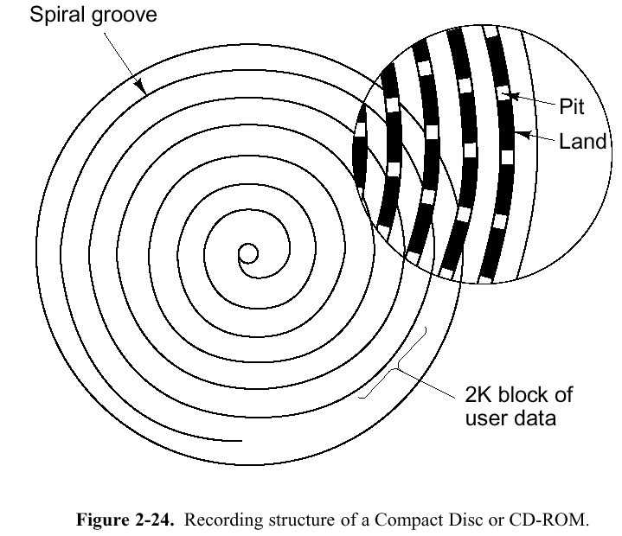
Optical Memory (CD-ROM)
Different from magnetic disk, there is only one physical track, spiralling from the middle of the disk toward the outer track.
But, it is customary to regard each circular path spanning 360 degrees as a separate track.
The disk is made from a poly-carbonate (functions as a clear glass base), coated with a highly reflective aluminium surface.
Digital data is imprinted as a series of microscopic (indented) pits and (un-indented) lands on the reflective surface.
Aluminum
Acrylic
Label
Pit
Land
Polycarbonate plastic
Cross-section

Slide 34
Optical Memory (CD-ROM)
The intensity of the reflected light of the laser changes as it encounters a transition from a pit to a land (light cancels out each other)
Dark spot represents a 1, bright spot represents a 0)
In practice, a more complex encoding scheme for representation. Each byte is represented by a 14-bit code for error detection capability.
Pit
Land
Reflection
Reflection
No reflection
Source
Detector
Source
Detector
Source
Detector
Transition from pit to land
0
1
0
0
1
0
0
0
0
1
0
0
0
1
0
0
1
0
0
1
0
Stored binary pattern

Slide 35
Optical Memory (CD-ROM)
Data is packed evenly across the disk in segments of the same size.
The pits are read by the laser at a constant linear velocity (CLV), i.e. the disk rotates more slowly for accesses near the outer edge than those near the centre.
Advantage of CD-ROM
large storage capacity;
can easily mass replicate inexpensively;
removable, allowing for archival storage.
Disadvantage of CD-ROM
read-only cannot be updated;
access time much longer than magnetic disk

Slide 36
Optical Memory (CD-ROM)
Capacity of CD-ROM
Track-to-track spacing = 1.6 um
Recordable width along the radius = 32.55 mm
= 32550 um
Number of tracks = 32550 / 1.6
= 20344 tracks
The total length of the spiral = 5.27 km
The linear velocity of the CD-ROM = 1.2 m/sec
The total time for reading/playing = 4391 sec
= 73.2 min
Data rate from disk = 176.4 Kbyte/sec
Total storage capacity for CD-ROM = 774.57 Mbytes

Slide 37
Optical Memory (DVD)
Digital Versatile Disk (DVD)
Same general design as CDs. High capacity disc capable of storing 4.7 to 17GB.
What is new is the use of
smaller pits (0.4 microns versus 0.8 microns for CDs)
a tighter spiral (0.74 microns between tracks versus 1.6 microns for CDs)
a red laser (at 0.65 microns versus 0.78 microns for CDs)
A 4.7 GB DVD can hold 133 min. of full-screen, full-motion video at high resolution (720 × 480), plus soundtracks in up to 8 languages and subtitles in 32 more.
Some DVD has dual layer, where different focus is used to read different layer.

Slide 38
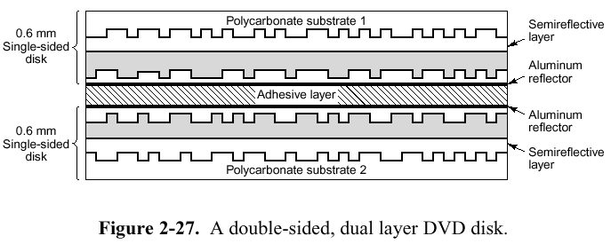
Optical Memory (DVD)
capacity
single-sided, single-layer (4.7 GB)
single-sided, dual-layer (8.5 GB)
doubled-sided, single-layer (9.4 GB)
doubled-sided, dual-layer (17 GB)

Slide 39
Optical Memory
BD-ROM (Blu-ray Discs-ROM)
HD DVD-ROM (High-density DVD-ROM)
Both are more expensive, have higher capacity and better quality than standard DVDs
BD-ROM currently have a storage capacity of up to 100GB and HD DVD-ROM up to 60GB.

